Slide 1
CSE 212 : Object Oriented Programming Sessional
Presented to - Md. Muhtadir Rahman Lecturer Department of Computer Science and Engineering Port City International University.
Project Title : Payroll System
Prepared by-
Prottoy Das (CSE 02107011)
Nurnabi Rahat (CSE 02107036)
Md. Abed Hossen Shymon (CSE 02107018)
Port city International University.
1

Slide 2
Contents
Problem Statement
Motivation
Problem Objectives
Preliminary Solutions
Project Stake Holders
Administrator
Employee
Board of directors
Projects Scopes
Functional Requirements
Non-Functional Requirements
Use Case Diagram
User Interface(UI)
Cost Analysis
Thank You
Q & A

Slide 3
Problem Statement
In a big organization or industry, there is a lot of employees.
As there is a lot of employees, it is hard to keep the information of all the employees together.
Moreover, the salary of those employees are more hard to keep track of as there is employees from different sector.

Slide 4
Motivation
In an industry it is sometimes hard to keep information of the employees.
As a result, employees are the one that suffers for this. Sometimes the employees don’t even get any salary because of this lack of system.
We also got motivated by our Lecturer Md. Muhtadir Rahman.
Thus we took the initiative to solve this problem.

Slide 5
PROBLEM OBJECTIVES
The main objective of the payroll management system is to provide an easy way out to automate all the functionalities.
It manages the details of the employees, their salary and their payment information.
The project is totally built at administrative end and thus only the administrator is guaranteed the access.
The purpose of this project is to reduce the manual work.

Slide 6
PRELIMINARY SOLUTION
The problem with the employees can be easily resolved by this “Payroll System” application.
The data of the employees will be stored in database by the system.

Slide 7
Project Stake Holders
Payroll system stack holders are:
Administrator.
Employee.
Board of directors.

Slide 8
Administrator: Administrator i.e. manager are focused on project management and how individual elements or departments of the business are run.
Employee: Employees are primary internal stakeholders. Employees have significant financial and time investments in the organization, and play a defining role in the strategy, tactics, and operations the organization carries out.
Board of directors: The board of directors are interested in maximizing the profit of the business makes and achieving a return for investors. Efficient business operations are therefore a prime focus for them.

Slide 9
Project Scopes:
Functional Requirement-
Login system for the user.
Enter list and view information.
Information insert, update and delete.
Non-Functional Requirement-
The user will be using XAMPP.
The information/ data will be saved in MySQL database.

Slide 10

Use Case Diagram
Log in
List
View
Insert
Administrator
Update
Board of director
Delete
10

Slide 11
Activity Diagram
END
Start
Log in
Exit
List
Menu
Help
Edit
Insert
Update
How to use
About us
Enter Information
(Id, name,salary)
Select ID
Exit
Go
Back
Edit
information
Delete
END
Save
Update
Back

Slide 12
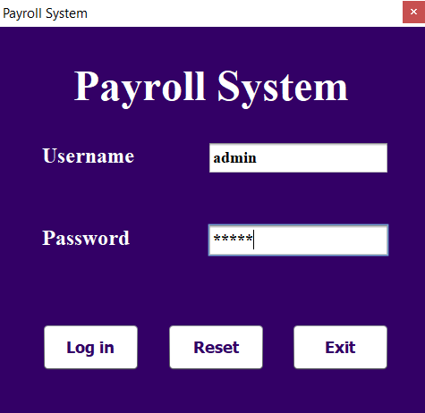
User Interface (UI)
Admin panel

Slide 13
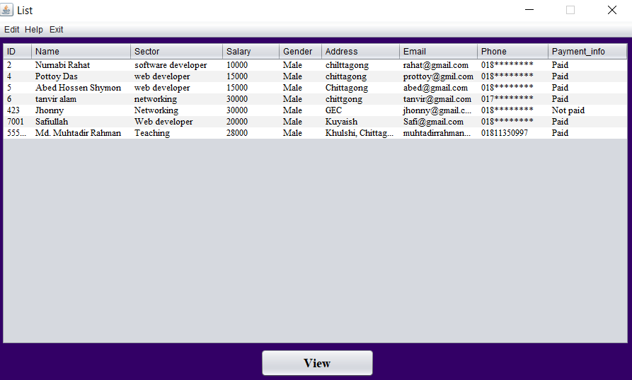
User Interface (UI)
List

Slide 14
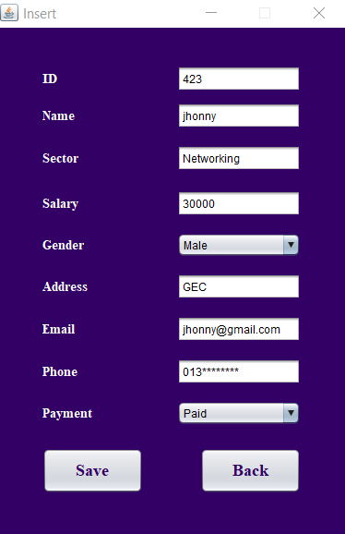
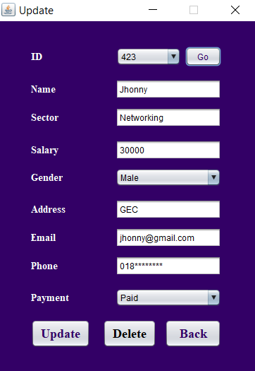
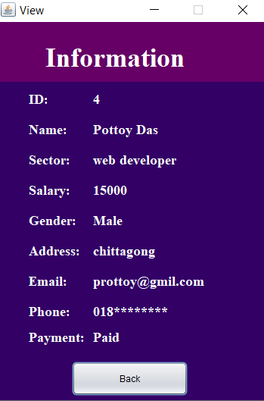
User Interface (UI)
Insert
Update
View

Slide 15
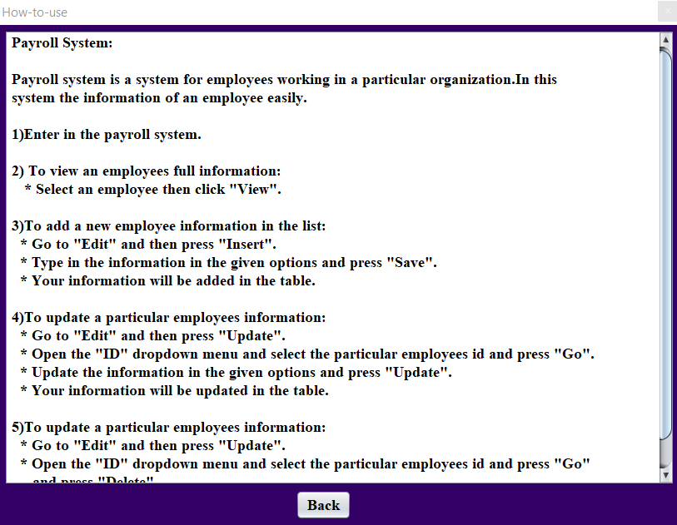
User Interface (UI)
How to use

Slide 16
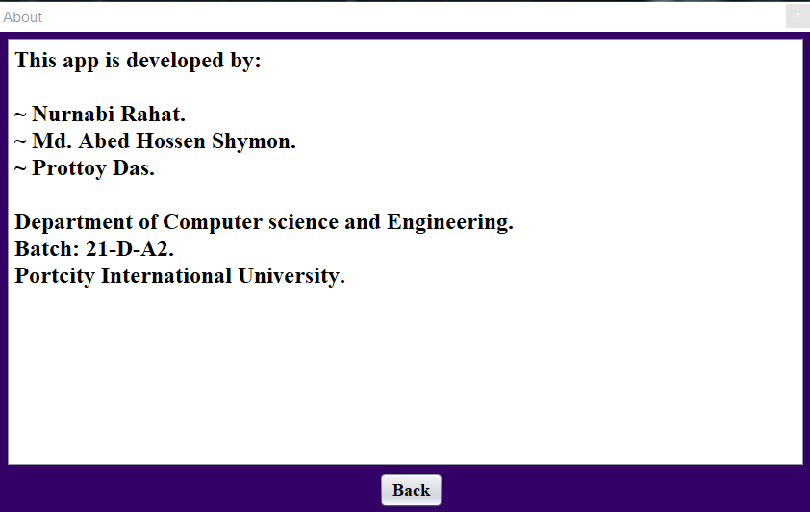
User Interface (UI)
About

Slide 17
Cost analysis
Serial No | Item | Amount
01 | Application Software Development | 1,00,000
02 | Personal PC | 2,90,000
03 | Database server | 50,000
 | Total | 4,40,000

Slide 18
Conclusion
“Payroll system” software developed for a company that has been designed to achieve maximum efficiency and reduce the time taken to handle the payroll activity. It is designed to replace an existing manual record system thereby reducing time taken for calculations and for storing data.

Slide 19
GitHub:
This project is uploaded on GitHub. The link is given below.
https://github.com/NNRahat/Payroll_System.git

Slide 20
THANK YOU

Slide 21
Q&A

